Slide 1
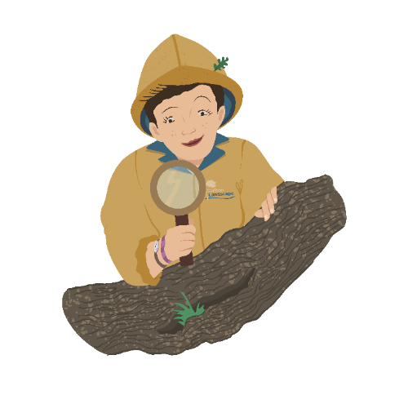
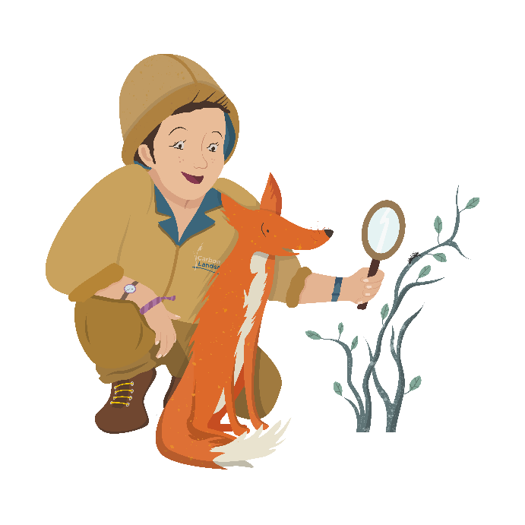
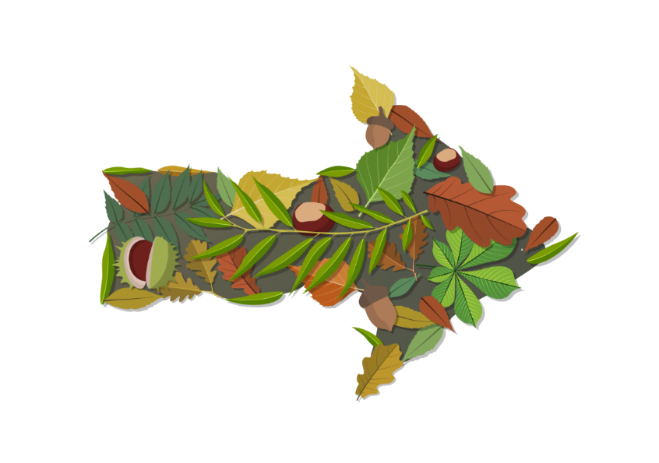
Who’s hiding in your…
…Woodlands and Meadows?
Let’s find out!

Slide 2
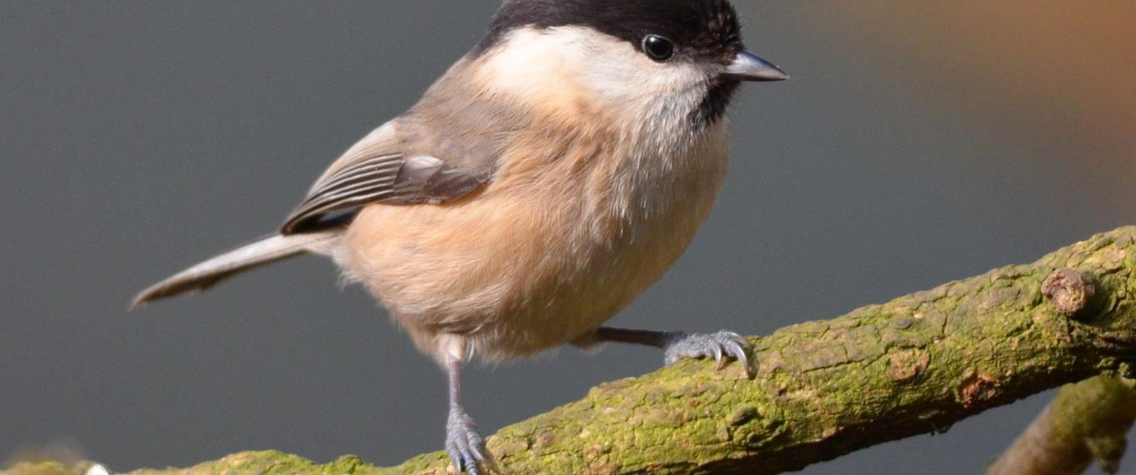
Who’s hiding in your… woodlands and meadows?
Question 1. Where do Willow Tits make their homes?
a) They nest high in the tree tops
b) They make nests under roofs
c) They make nests in rotting Willow tree trunks
Photo: Adam Jones

Slide 3
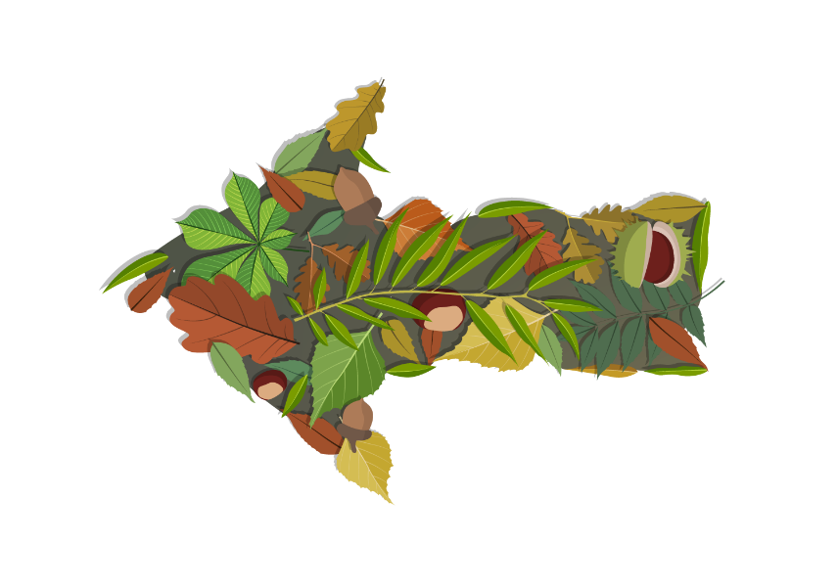
Who’s hiding in your… woodlands and meadows?
Not quite…
Try again!
Question 1. Where do Willow Tits make their homes?
a) They nest high in the tree tops
b) They make nests under roofs
c) They make nests in rotting Willow tree trunks
Photo: Adam Jones

Slide 4
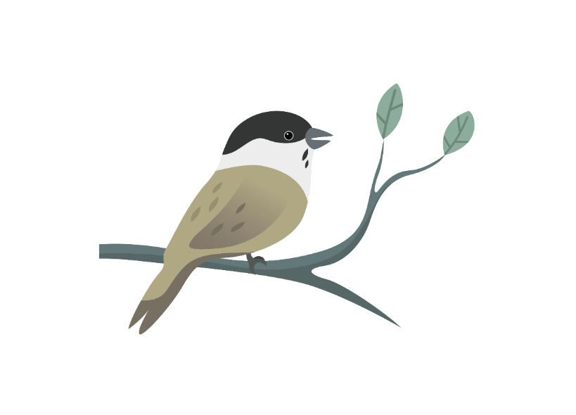
Did you know? More than 10% of the Willow Tits in the UK live in the North West, as they love the wet scrub on former industrial sites.
Question 1. Where do Willow Tits make their homes?
a) They nest high in the tree tops
b) They make nests under roofs
c) They make nests in rotting Willow tree trunks
Question 1. Where do Willow Tits make their homes?
Photo: Adam Jones

Slide 5
Who’s hiding in your… woodlands and meadows?
Click the speaker to listen
Question 2.
Which bird can you hear calling?
a) Kestrel
b) Willow Tit
c) Black headed gull
Photo: Ben Hall/2020VISION
Audio: Stanislas Wroza

Slide 6
Who’s hiding in your… woodlands and meadows?
Not quite…
Try again!
Question 2.
Which bird can you hear calling?
a) Kestrel
b) Willow Tit
c) Black headed gull
Photo: Ben Hall/2020VISION

Slide 7
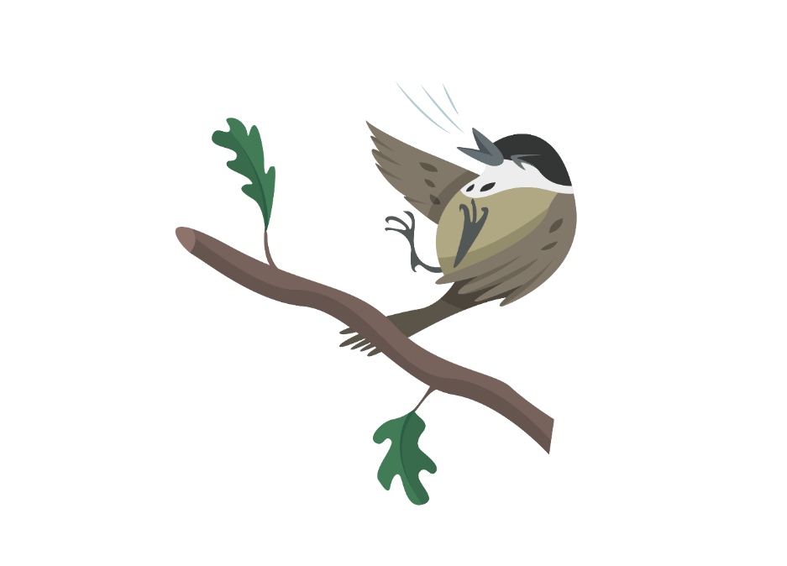
Who’s hiding in your… woodlands and meadows?
Did you know? Willow Tit numbers have gone down so much that there are now only a few thousand left in the UK.
Question 2.
Which bird can you hear calling?
a) Kestrel
b) Willow Tit
c) Black headed gull
Photo: Ben Hall/2020VISION

Slide 8
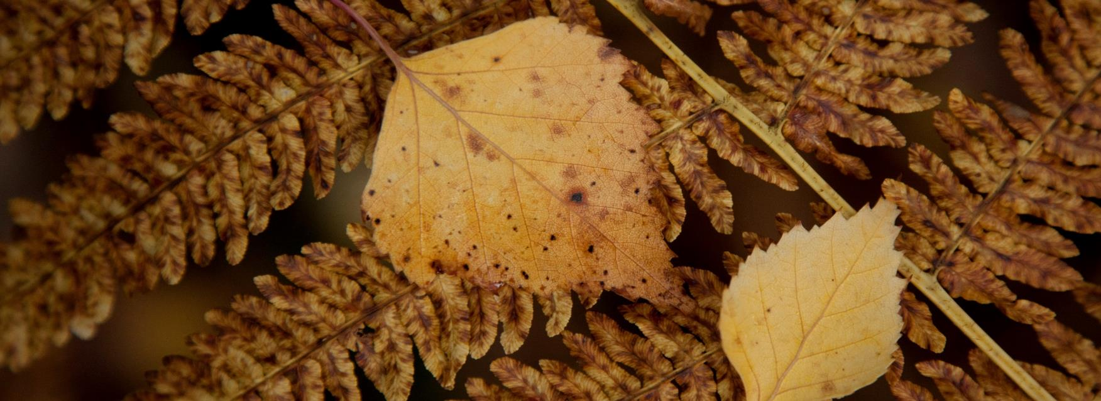
Who’s hiding in your… woodlands and meadows?
Question 3.
What tree is this leaf from?
a) Oak
b) Holly
c) Birch
Photo: Paul Hobson
Photo: Richard Burkmar

Slide 9
Who’s hiding in your… woodlands and meadows?
Not quite…
Try again!
Question 3.
What tree is this leaf from?
a) Oak
b) Holly
c) Birch
Photo: Paul Hobson
Photo: Richard Burkmar

Slide 10
Who’s hiding in your… woodlands and meadows?
Did you know? Many moth caterpillars eat Birch leaves, and the trees can be home to more than 300 species of insect.
Question 3.
What tree is this leaf from?
a) Oak
b) Holly
c) Birch
Photo: Paul Hobson
Photo: Richard Burkmar

Slide 11
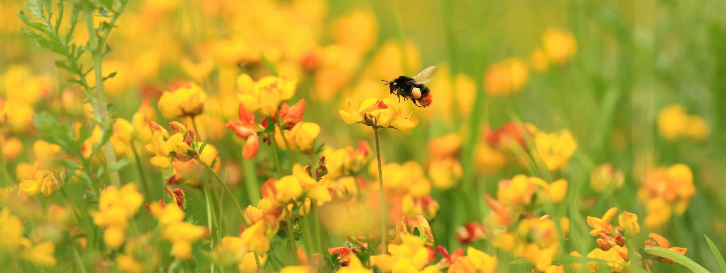
Who’s hiding in your… woodlands and meadows?
Question 4.
There are 24 species of bumblebee in the UK.
a) True
b) False
Photo: Jon Hawkins - Surrey Hills Photography

Slide 12
Who’s hiding in your… woodlands and meadows?
Not quite…
Try again!
Question 4.
There are 24 species of bumblebee in the UK.
a) True
b) False
Photo: Jon Hawkins - Surrey Hills Photography

Slide 13
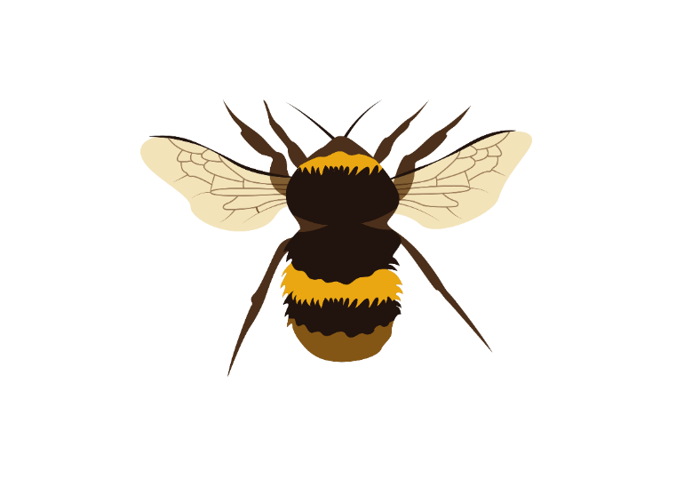
Who’s hiding in your… woodlands and meadows?
Did you know? In total there are over 250 species of bees in the UK! Why not make a home for some in your garden?
Question 4.
There are 24 species of bumblebee in the UK.
a) True
b) False
Photo: Jon Hawkins - Surrey Hills Photography / Ross Hoddinott/2020VISION

Slide 14
Who’s hiding in your… woodlands and meadows?
Question 5.
Which of these is NOT a type of orchid?
a) Bee Orchid
b) Frog Orchid
c) Badger Orchid
Photo: Peter Cairns/2020VISION
Photo: Guy Edwardes/2020VISION

Slide 15
Who’s hiding in your… woodlands and meadows?
Not quite…
Try again!
Question 5.
Which of these is NOT a type of orchid?
a) Bee Orchid
b) Frog Orchid
c) Badger Orchid
Photo: Peter Cairns/2020VISION
Photo: Guy Edwardes/2020VISION

Slide 16
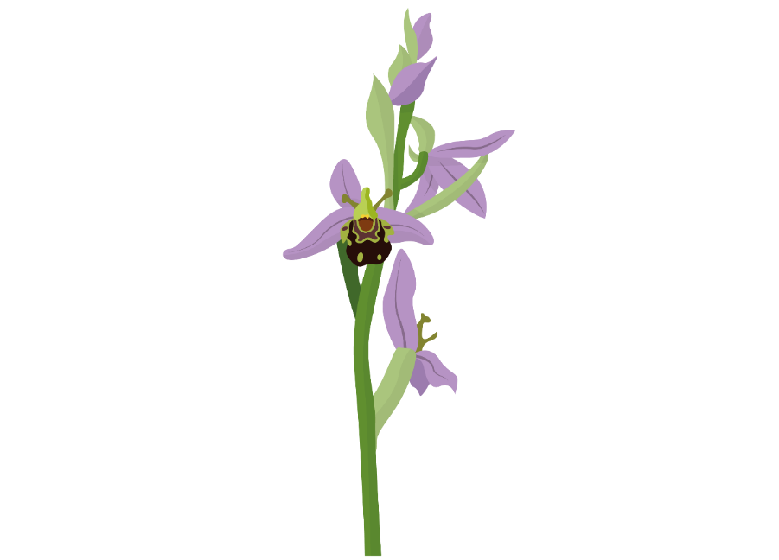
Who’s hiding in your… woodlands and meadows?
Did you know? Bees think that the flowers of Bee Orchids look like bees, so fly into them.
Question 5.
Which of these is NOT a type of orchid?
a) Bee Orchid
b) Frog Orchid
c) Badger Orchid
Photo: Guy Edwardes/2020VISION

Slide 17
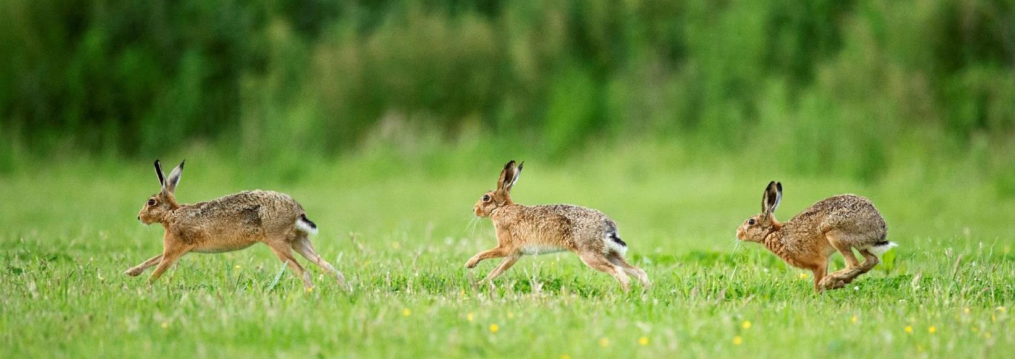
Who’s hiding in your… woodlands and meadows?
Question 6.
How fast can a Brown Hare run?
a) 15 mph
b) 45 mph
c) 100 mph
Photo: Richard Burkmar
Photo: Andy Rouse/2020VISION

Slide 18
Who’s hiding in your… woodlands and meadows?
Not quite…
Try again!
Question 6.
How fast can a Brown Hare run?
a) 15 mph
b) 45 mph
c) 100 mph
Photo: Richard Burkmar
Photo: Andy Rouse/2020VISION

Slide 19
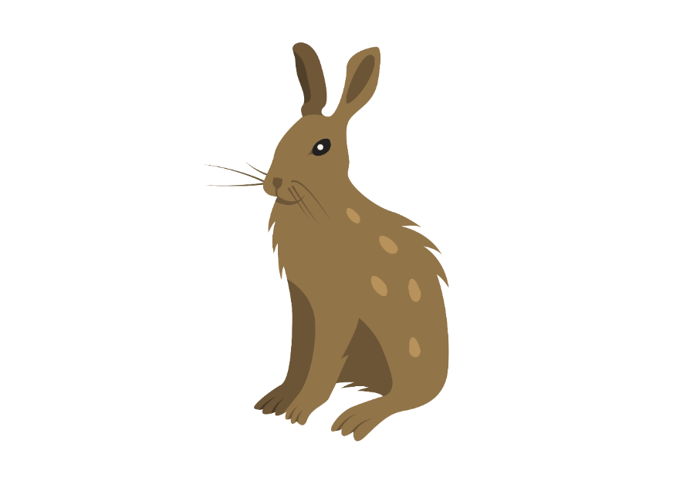
Who’s hiding in your… woodlands and meadows?
Did you know? That’s faster than the quickest person in the world!
Question 6.
How fast can a Brown Hare run?
a) 15 mph
b) 45 mph
c) 100 mph
Photo: Richard Burkmar
Photo: Andy Rouse/2020VISION

Slide 20
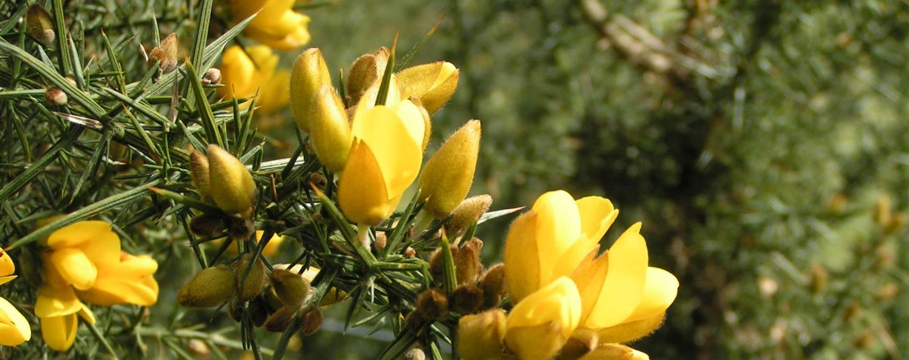
Who’s hiding in your… woodlands and meadows?
Question 7.
What’s this spiky, bright yellow plant?
a) Goose
b) Horse
c) Gorse
Photo:Richard Burkmar
Photo: Peter Cairns/2020VISION

Slide 21
Who’s hiding in your… woodlands and meadows?
Not quite…
Try again!
Question 7.
What’s this spiky, bright yellow plant?
a) Goose
b) Horse
c) Gorse
Photo:Richard Burkmar

Slide 22
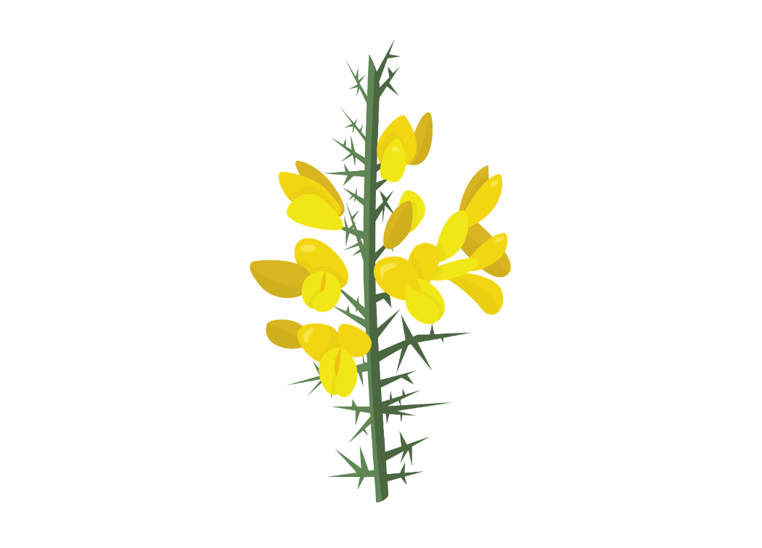
Who’s hiding in your… woodlands and meadows?
Did you know? Gorse flowers for a long time when not many other plants are in flower, making it an important nectar source for bees and other insects.
Question 7.
What’s this spiky, bright yellow plant?
a) Goose
b) Horse
c) Gorse
Photo:Richard Burkmar

Slide 23
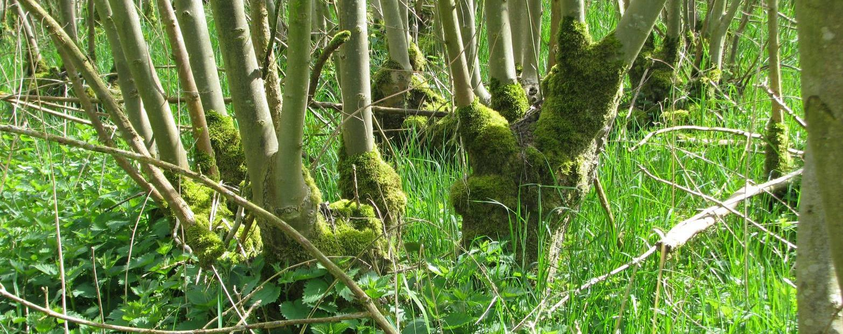
Who’s hiding in your… woodlands and meadows?
Question 8.
Coppicing is a method of cutting trees to encourage new growth. Which species of tree are often coppiced?
a) Willow, Hazel, Yew
b) Oak, Pine, Rowan
Photo: K.vliet CC BY-SA 4.0
Photo: Peter Cairns/2020VISION

Slide 24
Who’s hiding in your… woodlands and meadows?
Not quite…
Try again!
Question 8.
Coppicing is a method of cutting trees to encourage new growth. Which species of tree are often coppiced?
a) Willow, Hazel, Yew
b) Oak, Pine, Rowan
Photo: K.vliet CC BY-SA 4.0

Slide 25
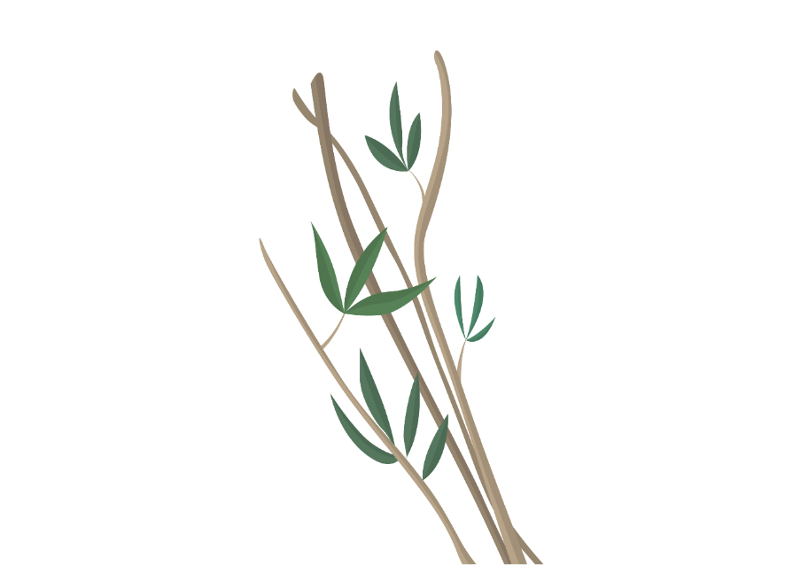
Who’s hiding in your… woodlands and meadows?
Did you know? Coppicing creates a range of different habitats, helping to increase biodiversity
Question 8.
Coppicing is a method of cutting trees to encourage new growth. Which species of tree are often coppiced?
a) Willow, Hazel, Yew
b) Oak, Pine, Rowan
Photo: K.vliet CC BY-SA 4.0

Slide 26
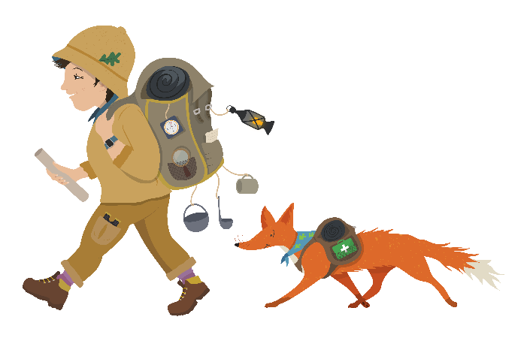
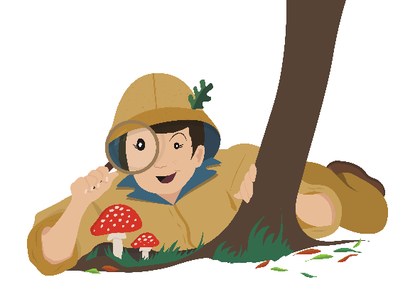
Thank you to the customers of Tesco Burscough Bridge for supporting this project!
Find out more about the wildlife in our landscape at www.carbonlandscape.org.uk
Background Audio: Dominic Garcia-Hall, XC406144. Accessible at www.xeno-canto.org/406144 CC 4.0

