Slide 1

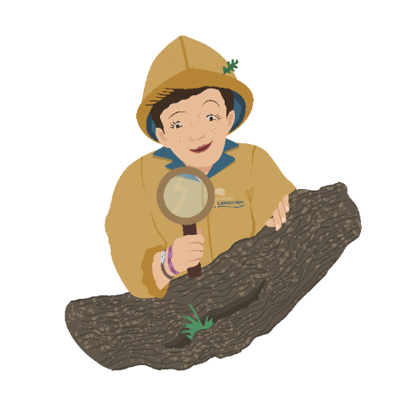
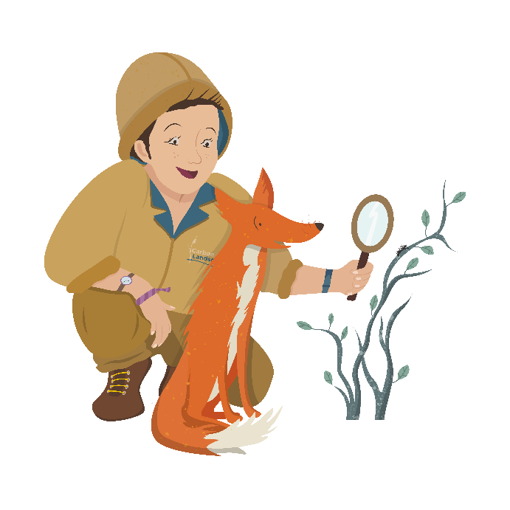
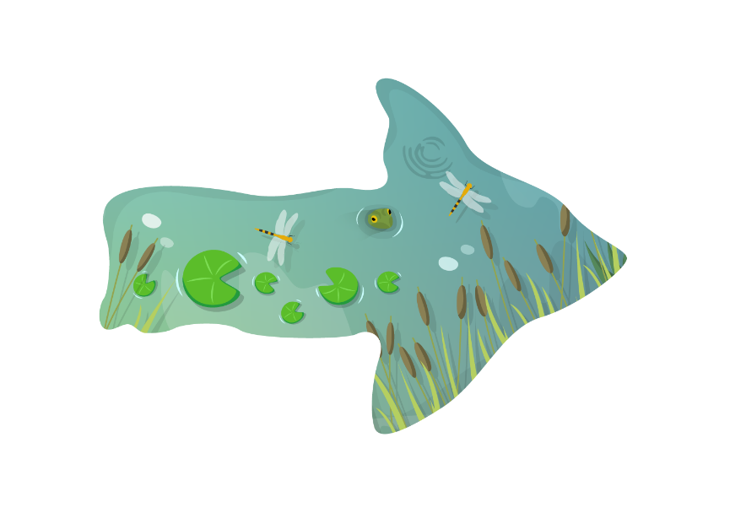




Who’s hiding in your…
…Wetland?
Let’s find out!

Slide 2


Who’s hiding in your… wetland?
Question 1.
What lives around
a pool like this?
a) Red Squirrel
b) White faced darter dragonfly
c) Komodo dragon
Photo: Ross Hoddinott/2020VISION

Slide 3

Who’s hiding in your… wetland?
Not quite…
Try again!
Question 1.
What lives around
a pool like this?
a) Red Squirrel
b) White faced darter dragonfly
c) Komodo dragon
Photo: Ross Hoddinott/2020VISION

Slide 4
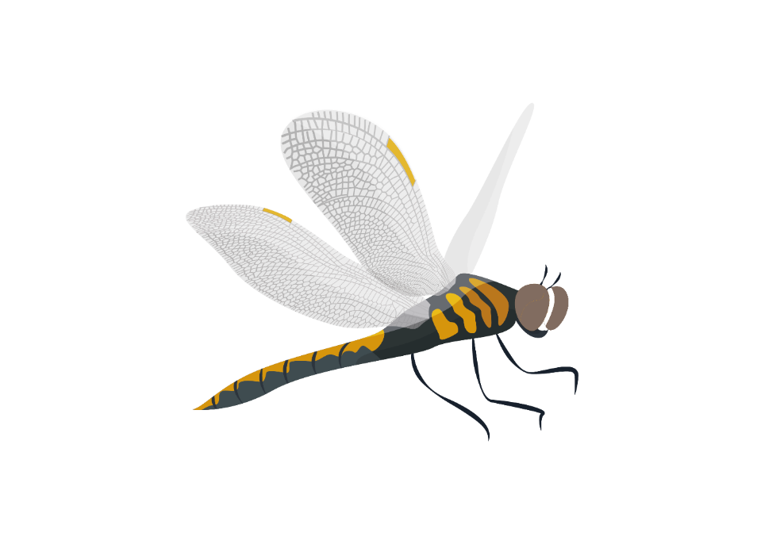

Who’s hiding in your… wetland?
Did you know? These dragonflies need the special conditions only found on some mosslands to make a home.
Did you know? Their white faces make them easy to tell apart from the other 35 types of dragonfly in the UK.
Question 1.
What lives around
a pool like this?
a) Red Squirrel
b) White faced darter dragonfly
c) Komodo dragon
Photo: Mark Hamblin/2020VISION
Photo: Ross Hoddinott/2020VISION

Slide 5
Who’s hiding in your… wetland?
Click the speaker to listen
Question 2.
Listen out! What type of bird is that?
a) Bittern
b) Cuckoo
c) Owl
Photo: Terry Whittaker/2020VISION

Slide 6
Who’s hiding in your… wetland?
Not quite…
Try again!
Question 2.
Listen out! What type of bird is that?
a) Bittern
b) Cuckoo
c) Owl
Photo: Terry Whittaker/2020VISION

Slide 7
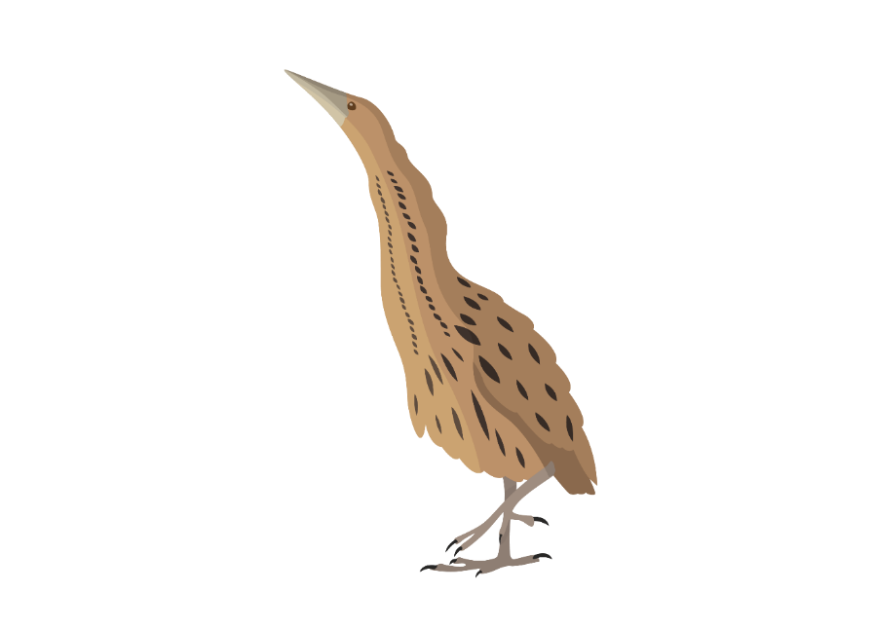
Who’s hiding in your… wetland?
Did you know? Bitterns are really hard to see as they blend into the reeds so well, but their ‘boom’s are easy to hear!
Question 2.
Listen out! What type of bird is that?
a) Bittern
b) Cuckoo
c) Owl
Recording: Leif Arvidsson, XC519898. Accessible at www.xeno-canto.org/519898. CC4.0
Photo: Terry Whittaker/2020VISION

Slide 8
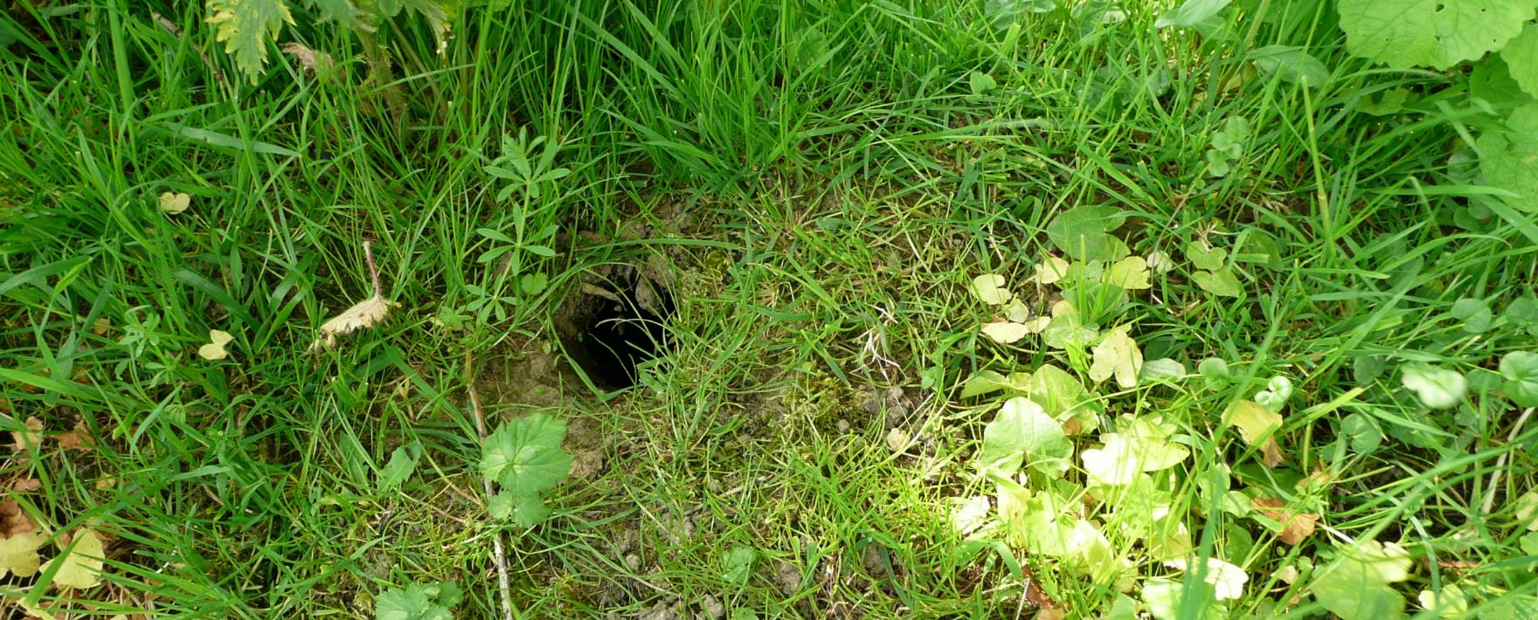
Who’s hiding in your… wetland?
Question 3.
Which is the biggest kind of vole?
a) Field Vole
b) Bank Vole
c) Water Vole
Photo: Karen Lloyd

Slide 9
Who’s hiding in your… wetland?
Not quite…
Try again!
Question 3.
Which is the biggest kind of vole?
a) Field Vole
b) Bank Vole
c) Water Vole
Photo: Karen Lloyd

Slide 10
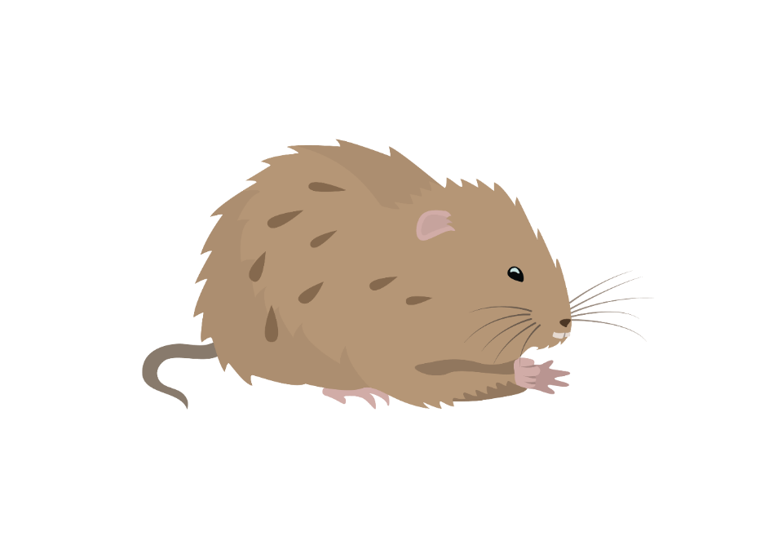
Who’s hiding in your… wetland?
Did you know? Water voles can be twice the size of Field Voles! Rats are even bigger, but have long, hairless tails, voles have shorter, furry tails.
Question 3.
Which is the biggest kind of vole?
a) Field Vole
b) Bank Vole
c) Water Vole
Photo: Karen Lloyd

Slide 11
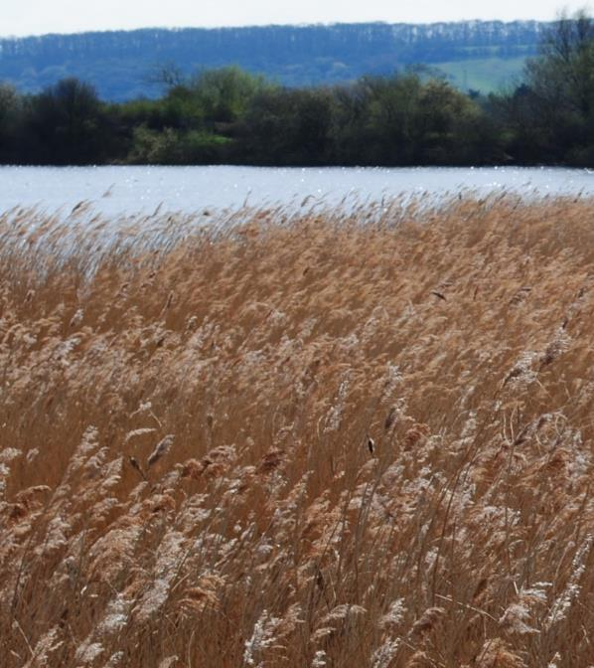
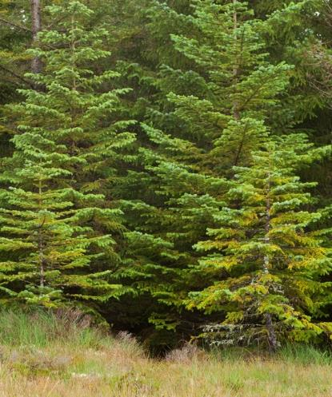
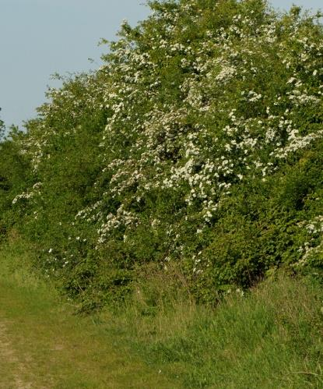
Who’s hiding in your… wetland?
Question 4.
Where does the Reed Warbler make its nest?
a) Reeds
b) Tree
c) Hedge
Photo: Amy Lewis/Mark Hamblin2020 Vision/ Chris Gomersall/2020VISION

Slide 12
Who’s hiding in your… wetland?
Not quite…
Try again!
Question 4.
Where does the Reed Warbler make its nest?
a) Reeds
b) Tree
c) Hedge
Photo: Stefan Johansson
Photo: Amy Lewis/Mark Hamblin2020 Vision/ Chris Gomersall/2020VISION

Slide 13

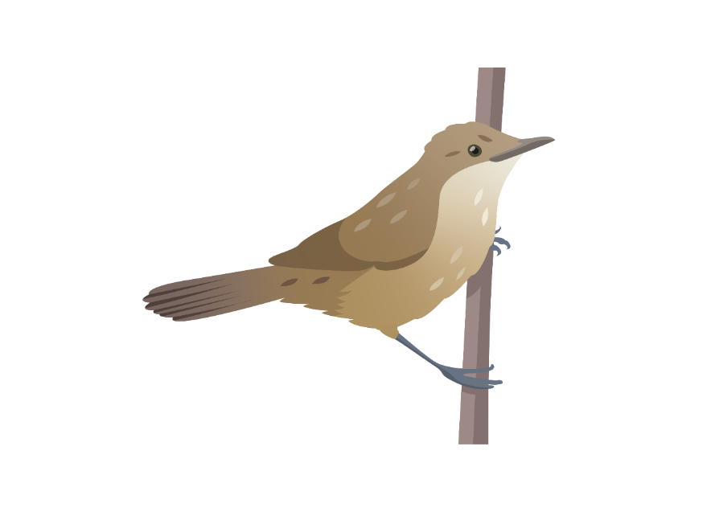
Who’s hiding in your… wetland?
Did you know? It can take over a week to build the nest, and some reed warblers re-use the materials to build a second nest. Great recycling!
Question 4.
Where does the Reed Warbler make its nest?
a) Reeds
b) Tree
c) Hedge
Photo: Stefan Johansson
Photo: Amy Lewis/Mark Hamblin2020 Vision/ Chris Gomersall/2020VISION

Slide 14
Who’s hiding in your… wetland?
Question 5.
Otters have returned to rivers because…
…the rivers have become less polluted.
b) …the otters have come back from holiday.
c) …people have planted pretty flowers.
Photo: Peter Cairns/2020VISION

Slide 15
Who’s hiding in your… wetland?
Not quite…
Try again!
Question 5.
Otters have returned to rivers because…
…the rivers have become less polluted.
b) …the otters have come back from holiday.
c) …people have planted pretty flowers.
Photo: Peter Cairns/2020VISION

Slide 16
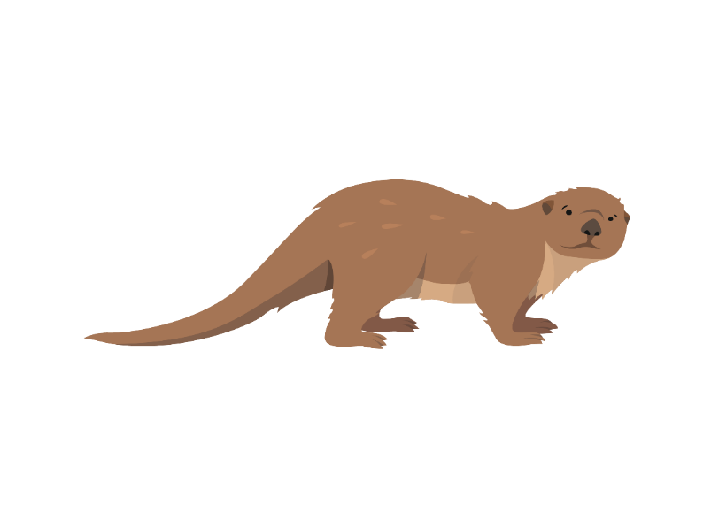
Who’s hiding in your… wetland?
Did you know? Otters will only live in clean water. The River Mersey used to be one of the most polluted rivers in Europe, but is now home to Otters.
…the rivers have become less polluted.
b) …the otters have come back from holiday.
c) …people have planted pretty flowers.
Question 5.
Otters have returned to rivers because…
…the rivers have become less polluted.
b) …the otters have come back from holiday.
c) …people have planted pretty flowers.
Photo: Peter Cairns/2020VISION

Slide 17
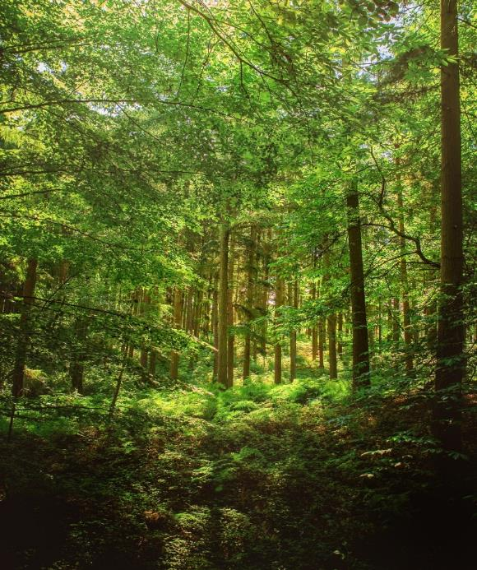
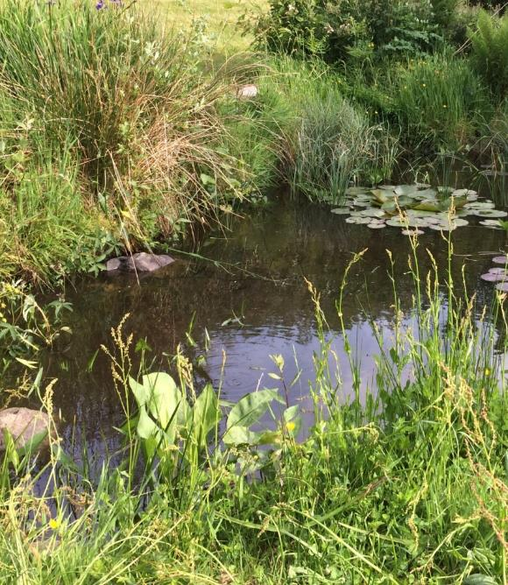
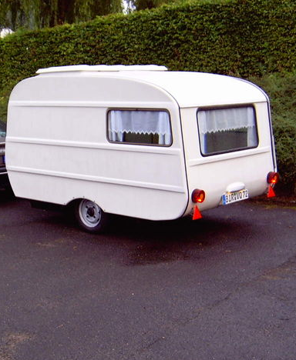
Who’s hiding in your… wetland?
Question 6.
Great Crested Newts live in…
a) …trees
b) …ponds
c) …caravans
Photo: Jon Hawkins - Surrey Hills Photography/Anna Williams

Slide 18
Who’s hiding in your… wetland?
Not quite…
Try again!
Question 6.
Great Crested Newts live in…
a) …trees
b) …ponds
c) …caravans
Photo: Jon Hawkins - Surrey Hills Photography/Anna Williams

Slide 19
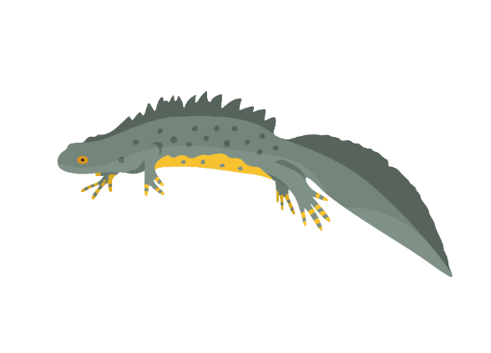
Who’s hiding in your… wetland?
Did you know? The number of Great Crested Newts in the UK has declined so much that we now dig special ponds in our wetlands to help them survive.
Did you know? You might also spot Smooth Newts and Palmate Newts.
Question 6.
Great Crested Newts live in…
a) …trees
b) …ponds
c) …caravans
Photo: Jon Hawkins - Surrey Hills Photography/Anna Williams

Slide 20
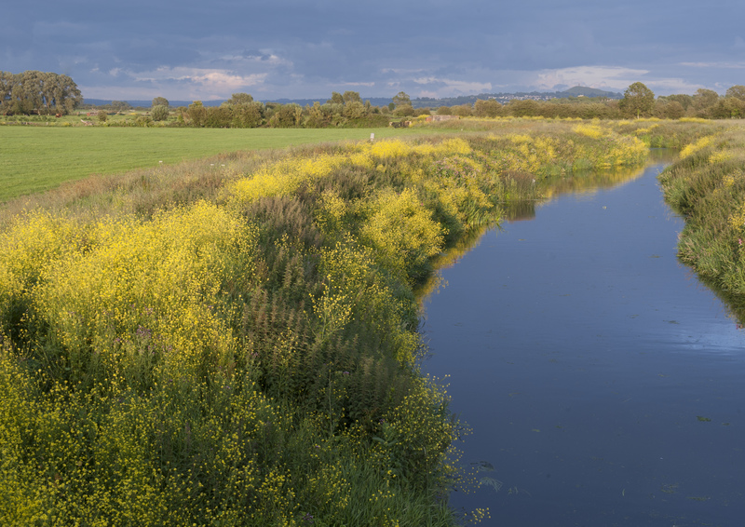
Who’s hiding in your… wetland?
Question 7.
Who might you see fishing along the canal?
a) Pink Footed Goose
b) Kingfisher
c) Mute Swan
Photo: Paul Harris/ 2020VISION

Slide 21
Who’s hiding in your… wetland?
Not quite…
Try again!
Question 7.
Who might you see fishing along the canal?
a) Pink Footed Goose
b) Kingfisher
c) Mute Swan
Photo: Paul Harris/ 2020VISION

Slide 22
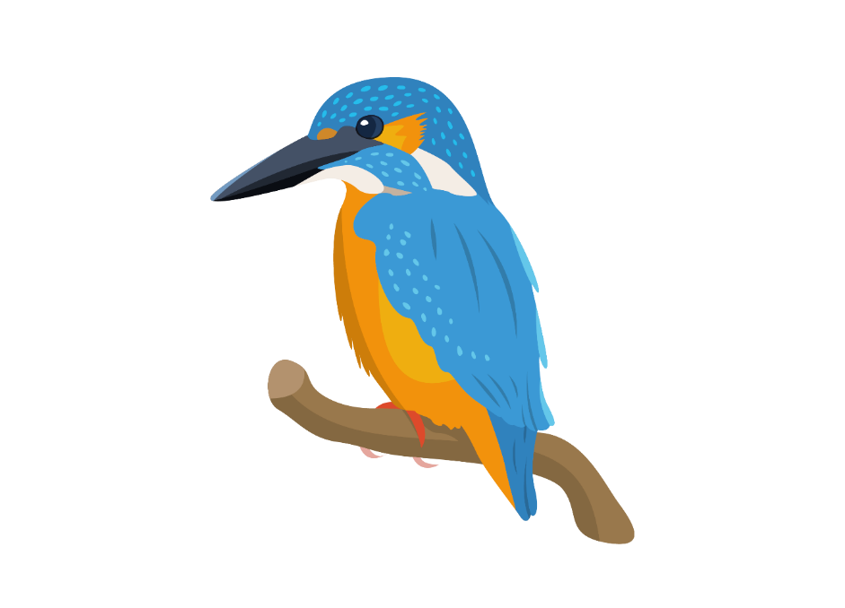
Who’s hiding in your… wetland?
Did you know? Kingfishers also eat frogs, insects, spiders, reptiles and mammals.
Question 7.
Who might you see fishing along the canal?
a) Pink Footed Goose
b) Kingfisher
c) Mute Swan
Photo: Paul Harris/ 2020VISION

Slide 23
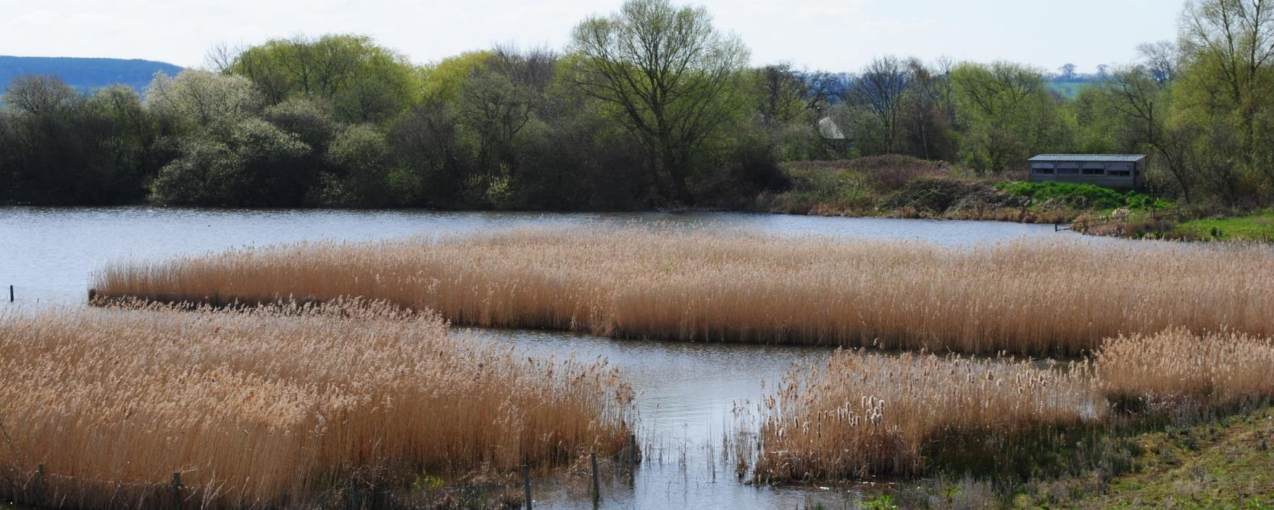


Who’s hiding in your… wetland?
Question 8.
What’s the bright flower that you might find on the edge of the water?
a) Black Flag Iris
b) Red Sheet Iris
c) Yellow Flag Iris
Photo: Amy Lewis

Slide 24
Who’s hiding in your… wetland?
Not quite…
Try again!
Question 8.
What’s the bright flower that you might find on the edge of the water?
a) Black Flag Iris
b) Red Sheet Iris
c) Yellow Flag Iris
Photo: Amy Lewis

Slide 25
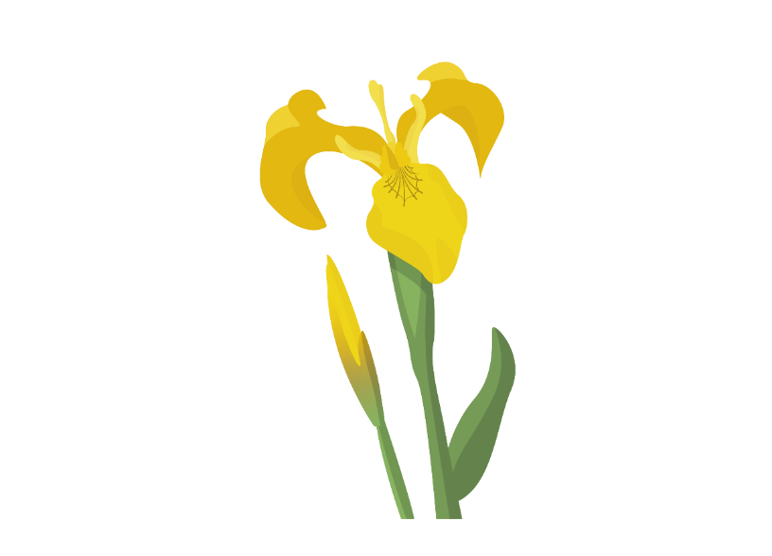
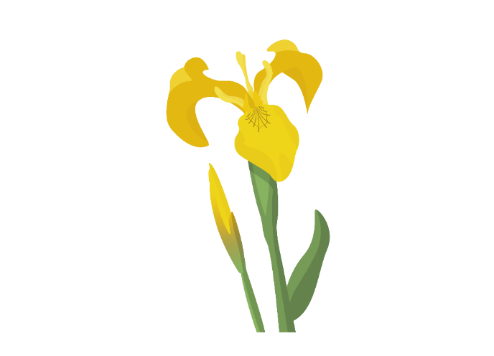

Who’s hiding in your… wetland?
Did you know? Yellow Flag Iris can grow up to a metre and a half tall!
Question 8.
What’s the bright flower that you might find on the edge of the water?
a) Black Flag Iris
b) Red Sheet Iris
c) Yellow Flag Iris
Photo: Amy Lewis

Slide 26
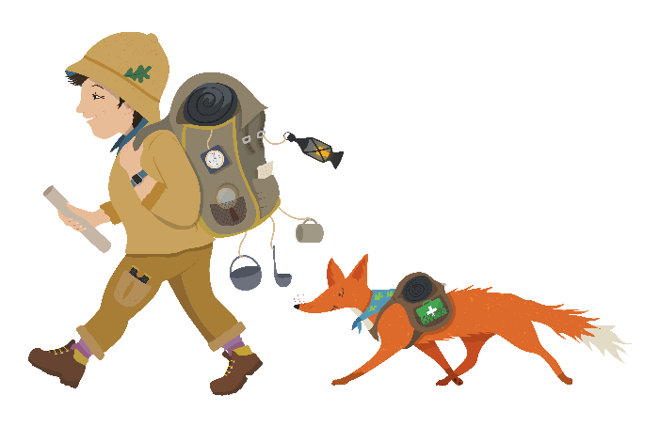




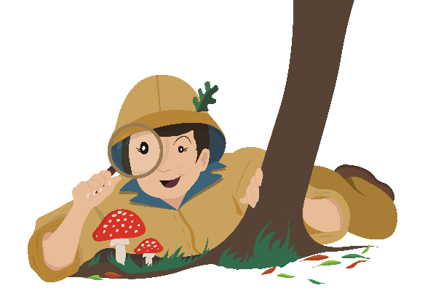
Who’s hiding in your… wetland?
Thank you to the customers of Tesco Burscough Bridge for supporting this project!
Find out more about the wildlife in our landscape at www.carbonlandscape.org.uk
Background audio: Dominic Garcia-Hall, XC393959. Accessible at www.xeno-canto.org/393959. CC4.0

