Slide 1
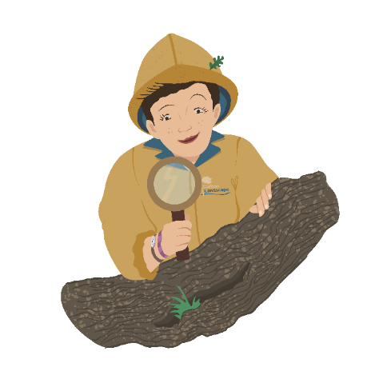
Who’s hiding in your…
…Mossland?
Let’s find out!

Slide 2
Who’s hiding in your… mossland?
Question 1. a) Fruit
What do sundews eat? b) Insects
c) Chocolate
Photo: Mark Hamblin/2020VISION

Slide 3
Who’s hiding in your… mossland?
Not quite…
Try again!
Question 1. a) Fruit
What do sundews eat? b) Insects
c) Chocolate
Photo: Mark Hamblin/2020VISION

Slide 4
Who’s hiding in your… mossland?
Did you know? The ground doesn’t have enough nutrients for the sundew, so it gets extra nutrients from insects! Their leaves are covered in a sticky mucus that traps the insects, the leaf then curls round the insect to digest it.
Question 1.
What do sundews eat? b) Insects
Photo: Mark Hamblin/2020VISION

Slide 5
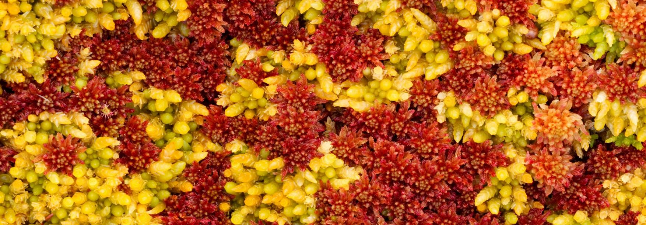
Who’s hiding in your… mossland?
Question 2. a) Twice its own weight
How much water can Sphagnum hold? b) 20 times its own weight
c) 200 times its own weight
Photo: Mark Hamblin/2020VISION

Slide 6
Who’s hiding in your… mossland?
Not quite…
Try again!
Question 2. a) Twice its own weight
How much water can Sphagnum hold? b) 20 times its own weight
c) 200 times its own weight
Photo: Mark Hamblin/2020VISION

Slide 7
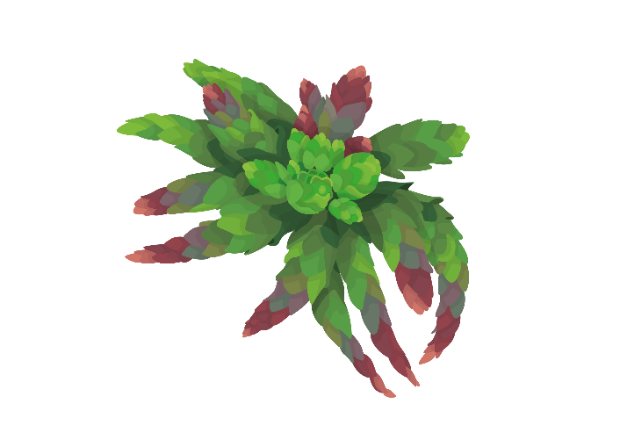
Who’s hiding in your… mossland?
Did you know? This can help slow the flow of rainfall, decreasing the chance of flooding
Question 2. a) Twice its own weight
How much water can Sphagnum hold? b) 20 times its own weight
c) 200 times its own weight
Photo: Mark Hamblin/2020VISION

Slide 8
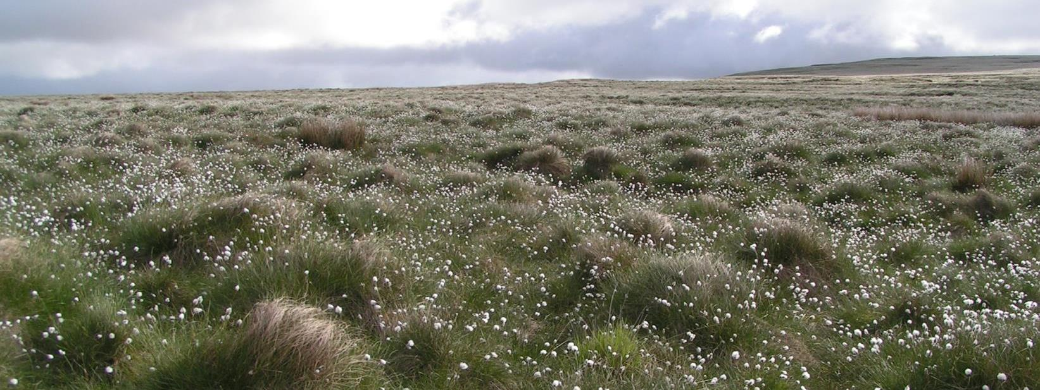
Who’s hiding in your… mossland?
Question 3. a) Wool Grass
Look over the mossland, b) Denim Grass
what’s that plant with fluffy, white seed heads? c) Cotton Grass
Photo: Richard Burkmar

Slide 9
Who’s hiding in your… mossland?
Not quite…
Try again!
Question 3. a) Wool Grass
Look at over the mossland, b) Denim Grass
what’s that plant with fluffy, white seed heads? c) Cotton Grass
Photo: Richard Burkmar

Slide 10
Who’s hiding in your… mossland?
Did you know? Cotton Grass is actually a sedge, not a grass!
Question 3. a) Wool Grass
Look at over the mossland, b) Denim Grass
what’s that plant with fluffy, white seed heads? c) Cotton Grass
Photo: Richard Burkmar

Slide 11
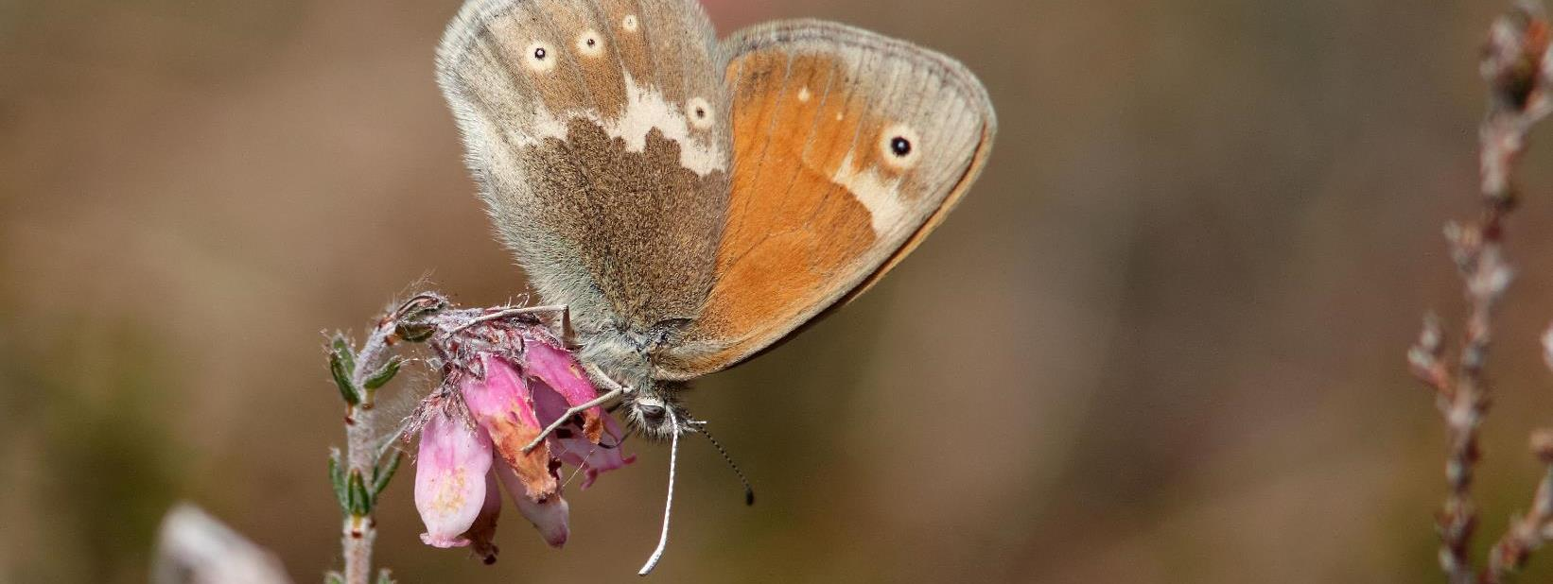
Who’s hiding in your… mossland?
Question 4. a) Large Heath
Which locally extinct butterfly b) Duke of Burgundy
is being brought back c) Marsh Fritillary
to the mosslands?
Photo: Stefan Johansson

Slide 12
Who’s hiding in your… mossland?
Not quite…
Try again!
Question 4. a) Large Heath
Which locally extinct butterfly b) Duke of Burgundy
is being brought back c) Marsh Fritillary
to the mosslands?
Photo: Stefan Johansson

Slide 13
Who’s hiding in your… mossland?
Did you know? The Large Heath Butterfly is also known as the Manchester Argus, it has been missing from local mosslands for over 150 years. It gets nectar from the flowers of Cross Leaved Heath.
Question 4. a) Large Heath
Which locally extinct butterfly b) Duke of Burgundy
is being brought back c) Marsh Fritillary
to the mosslands?
Photo: Stefan Johansson

Slide 14
Who’s hiding in your… mossland?
Question 5. a) To burn as a fuel
Why was peat cut and removed b) To use as compost for plants
from the land in the past? c) Both of the above
Photo: Peter Cairns/2020VISION

Slide 15
Who’s hiding in your… mossland?
Almost…
Try again!
Question 5. a) To burn as a fuel
Why was peat cut and removed b) To use as compost for plants
from the land in the past? c) Both of the above
Photo: Peter Cairns/2020VISION

Slide 16
Who’s hiding in your… mossland?
Did you know? Around 80% of the UK’s peatlands (also known as mosslands) have been damaged by activities like these.
Question 5. a) To burn as a fuel
Why was peat cut and removed b) To use as compost for plants
from the land in the past? c) Both of the above (for fuel & compost)
Photo: Peter Cairns/2020VISION

Slide 17
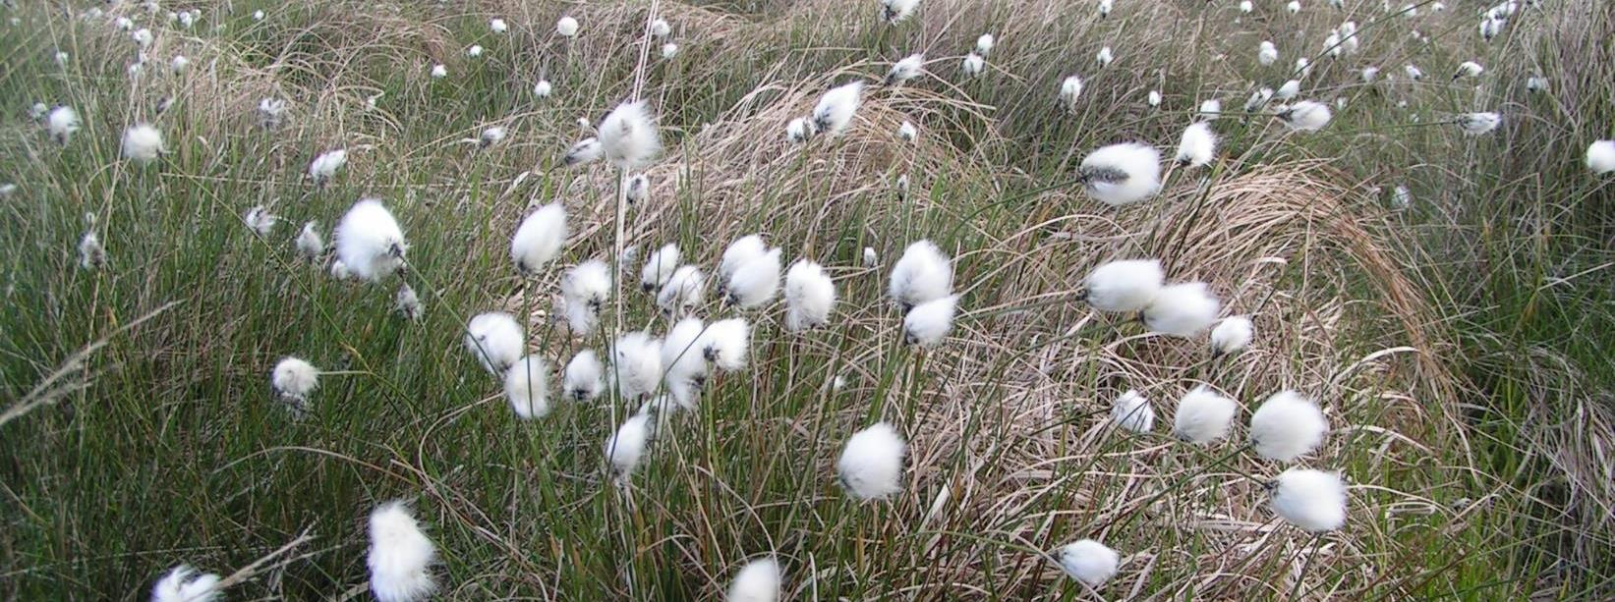
Who’s hiding in your… mossland?
Click the speaker to listen
Question 6. a) Bog Bush Cricket
What’s that we can hear b) Tree Cricket
in the Cotton Grass? c) Flower Cricket
Photo: Richard Burkmar
Audio:Baudewijn Odé, XC446561. Accessible at www.xeno-canto.org/446561 CC 4.0

Slide 18
Who’s hiding in your… mossland?
Not quite…
Try again!
Question 6. a) Bog Bush Cricket
What’s that we can hear b) Tree Cricket
in the Cotton Grass? c) Flower Cricket
Photo: Richard Burkmar

Slide 19
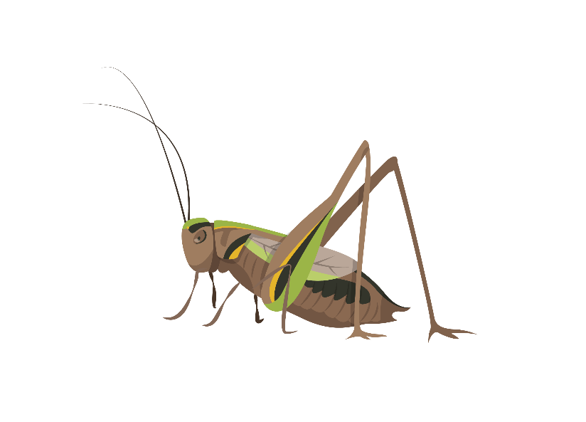
Who’s hiding in your… mossland?
Did you know? Crickets usually have long antennae, while grasshoppers have short antennae.
Question 6. a) Bog Bush Cricket
What’s that we can hear b) Tree Cricket
in the Cotton Grass? c) Flower Cricket
Photo: Richard Burkmar

Slide 20
Who’s hiding in your… mossland?
Question 7. a) 3 years
How long does it take for b) 1000 years
1 metre of peat to form? c) 2 million years
Photo: Peter Cairns/2020VISION

Slide 21
Who’s hiding in your… mossland?
Not quite…
Try again!
Question 7. a) 3 years
How long does it take for b) 1000 years
1 metre of peat to form? c) 2 million years
Photo: Peter Cairns/2020VISION

Slide 22
Who’s hiding in your… mossland?
Did you know? Peat is made by plants decomposing very slowly in wet, low oxygen, acidic conditions.
Question 7. a) 3 years
How long does it take for b) 1000 years
1 metre of peat to form? c) 2 million years
Photo: Peter Cairns/2020VISION

Slide 23
Who’s hiding in your… mossland?
Question 8. a) Twice as much
How much carbon does peat b) The same amount
store compared to forests? c) Less
Photo: Peter Cairns/2020VISION

Slide 24
Who’s hiding in your… mossland?
Not quite…
Try again!
Question 8. a) Twice as much
How much carbon does peat b) The same amount
store compared to forests? c) Less
Photo: Peter Cairns/2020VISION

Slide 25
Who’s hiding in your… mossland?
Did you know? The UK has 13% of all the world’s blanket bog!
Question 8. a) Twice as much
How much carbon does peat b) The same amount
store compared to forests? c) Less
Photo: Peter Cairns/2020VISION

Slide 26
Thank you to the customers of Tesco Burscough Bridge for supporting this project!
Find out more about the wildlife in our landscape at www.carbonlandscape.org.uk
Background audio: Dominic Garcia-Hall, XC393959. Accessible at www.xeno-canto.org/393959. CC4.0

