Slide 1
Volunteering within the
Carbon Landscape

Slide 2
What is Volunteering?
Dictionary.com

Slide 3
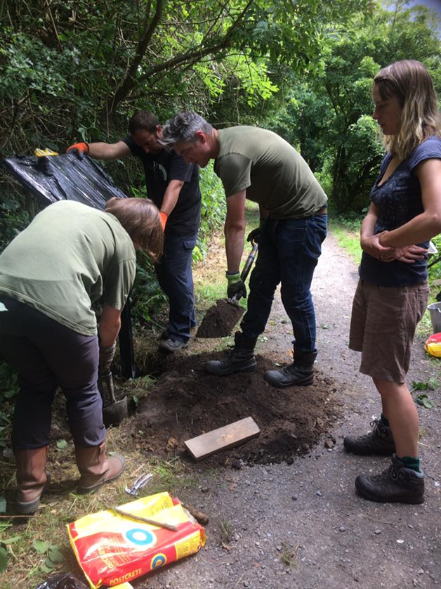
Being a Carbon Landscape Volunteer
It’s an amazing opportunity to work with 14 organisations over 22 projects throughout Wigan, Warrington and Salford

Slide 4
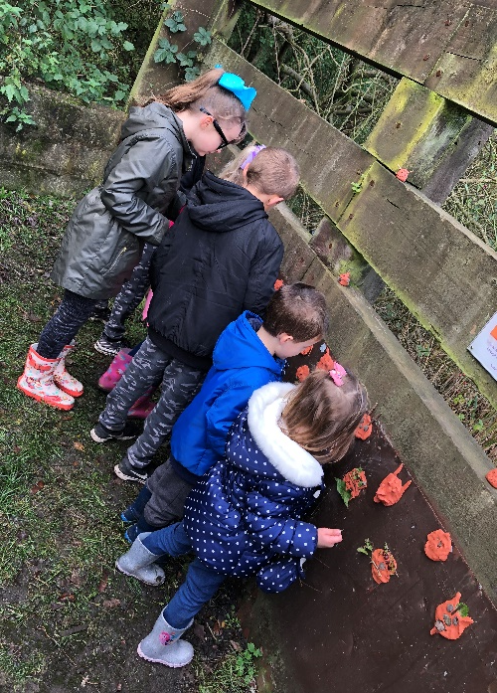
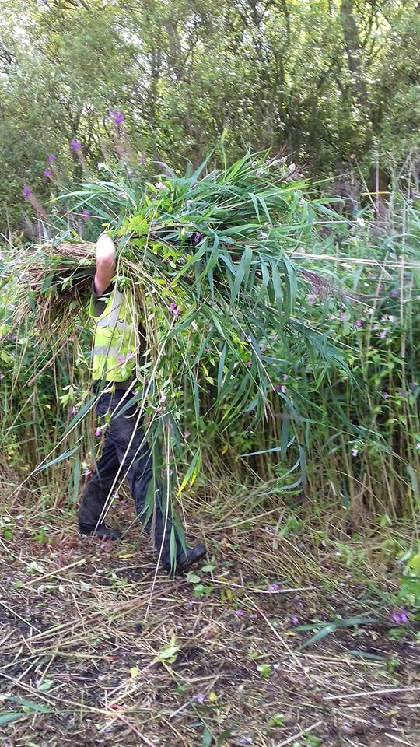
What you could volunteer for
Practical habitat restoration and management.
Biological recording.
Inspire and support local communities.
Assist innovative education.
Help improve access (Carbon Trail).
Help deliver fun events.
Assist in project support work and administration work.
2020VISION

Slide 5
What do you gain from volunteering
Develop new skills and knowledge
Some equipment
Take ownership of your wildlife havens
Discover your local area
Feel healthier
Expenses
Leave a legacy for nature
Connect with nature with like minded people
Connect with your heritage
Inspire your community
Personal development
Rewards and recognition package
Administration skills
Free Training

Slide 6
Expenses
You are able to claim up to £5.00 a day
Ask for an expenses form from your activity leader.
Each month simply fill out the form, get it signed and send it to the Carbon Landscape Team.
Hey presto ☺

Slide 7
How to become a volunteer
Either visit our website CarbonLandscape.org.uk or fill in our sign up forms.
It only takes a few minutes we promise……

Slide 8
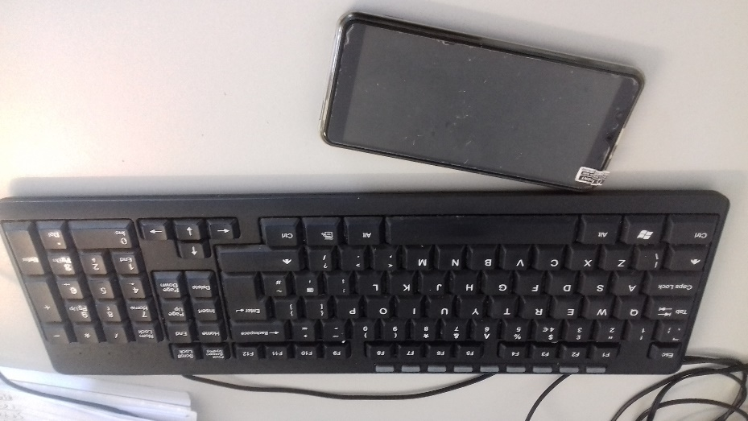
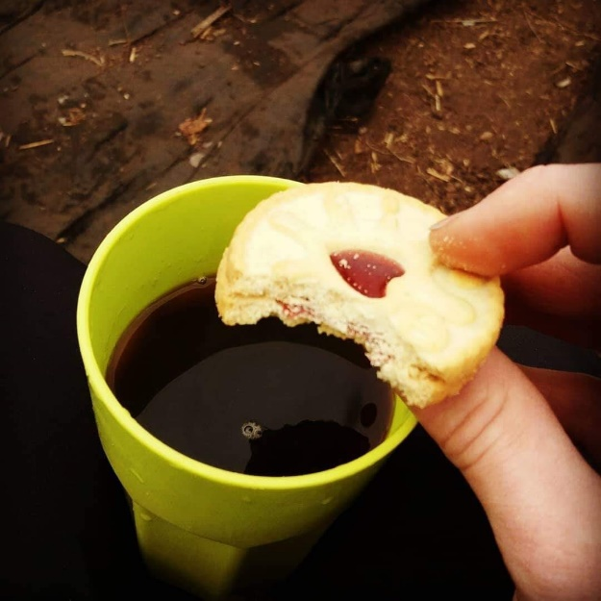
What’s next….
Come in and meet us
(After Covid-19 of course)
We call or email you
Notes:
We will give you a call or send you an email with suggestion on who to contact to get involved. We send you a few questions to make sure that you’re okay to volunteer and not at risk due to the coronavirus.
We will give you a little induction and go through what you are interested in volunteering with then get you involved

Slide 9
Current Opportunities
General Conservation
Wetland
Carbon Landscape Hit Squad throughout the Carbon Landscape
Peatland
Lancashire Peatlands Initiative
Wigan Flashes – Tuesday – Friday (combination of tasks!)
Grassland
Please keep up to date on volunteer opportunities on our website.
Bickershaw – Wednesday – Friday (combination of tasks)

Slide 10
Any Questions?
?

